Slide 1
Sales Data Analysis presentation

Slide 2
Agenda
Dataset and Data Cleaning
Analysis and Visualizations
Dashboard and Key Findings
Recommendations and Conclusion

Slide 3
Dataset and Data Cleaning
1. Dataset Overview
Dataset: Sales Dataset
Records: Approximately 9,994 rows (verify your final cleaned file).
Data includes: Order ID, Order Date, Customer Segment, Region, Category, Sales, Quantity, Discount, and Profit.
Purpose: To analyze sales performance and identify business trends.
2. Data Cleaning
Checked and corrected data types.
Removed duplicate Row IDs.
Removed blank rows in Order Date.
Checked invalid values in numeric columns.
Filled missing Postal Code values using the mode.
Created a new column called Profit Status.
3. Tools Used
Microsoft Excel
Microsoft Power BI

Slide 4
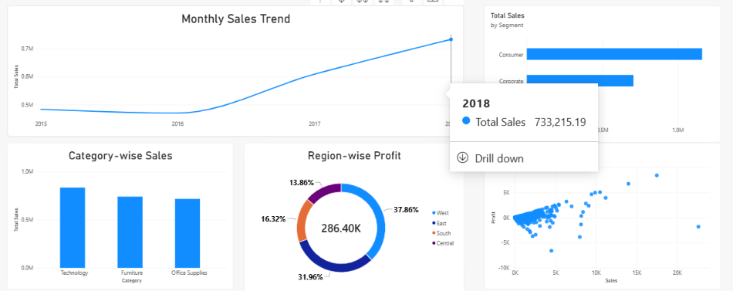

Analysis And Visualization
Exploratory Data Analysis (EDA)
Analyzed sales, profit, quantity, and orders.
Created four DAX measures in Power BI:
Total Sales
Total Profit
Total Quantity
Total Orders
Compared sales across product categories, regions, and customer segments.
Examined yearly sales trends and the relationship between sales and profit.
Visualizations Created
Line chart — Sales Trend
Column chart — Category-wise Sales
Donut chart — Region-wise Profit
Bar chart — Sales by Customer Segment
Scatter chart — Sales vs Profit

Slide 5
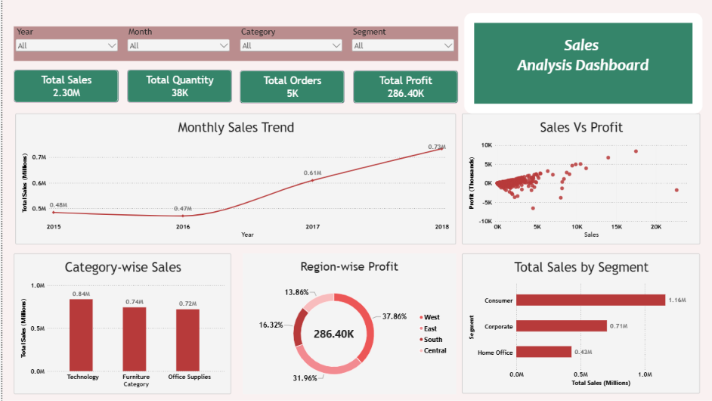
Dashboard and key Findings
Dashboard Features
Four KPI cards: Total Sales, Total Quantity, Total Orders, and Total Profit.
Slicers for Year, Month, Category, and Segment.
Five interactive charts to explore sales performance.

Slide 6
Recommendations and Conclusion
Recommendations
Promote profitable Technology products.
Study the West region's successful strategies and evaluate whether they can work in other regions.
Review discounts, pricing, and costs for transactions with negative profit.
Develop suitable marketing campaigns for Consumer customers.
Conclusion
Power BI helped identify important sales and profit trends.
The dashboard makes it easier to compare categories, regions, and customer segments.
These insights can support better business decisions and improve profitability.

Slide 7
Thank you

